Slide 1
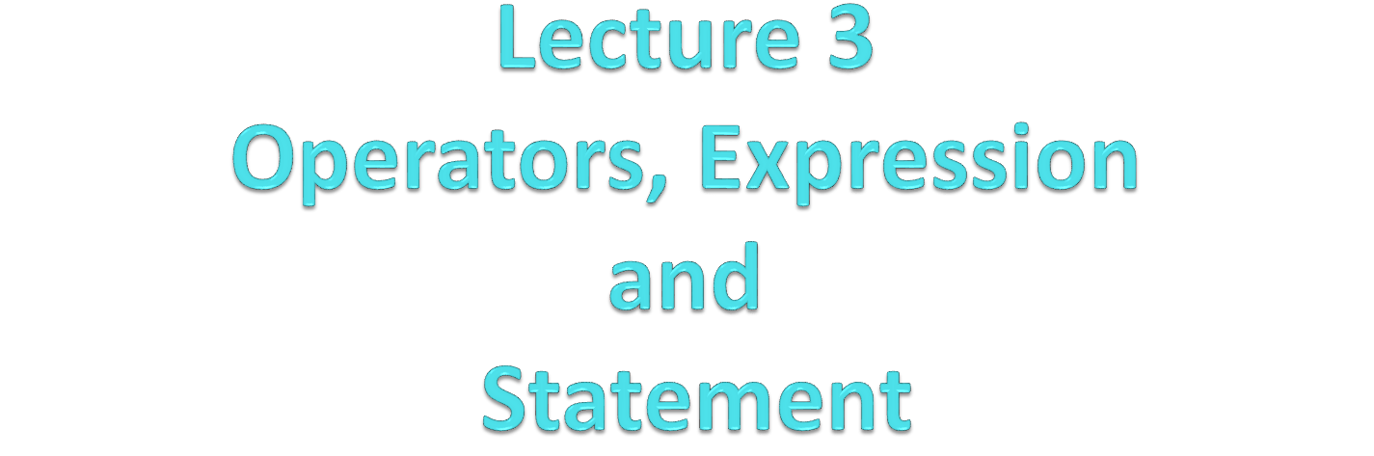

Slide 2
Language features
Each programming language feature exists to express a fundamental idea to performing computations
  For example
    + : addition
    * : multiplication
    if (expression) statement else statement ; selection
    while (expression) statement ; iteration
    f(x); function/operation
    …
We combine language features to create programs

Slide 3
Expression
Expressions are the fundamental means of specifying computations in a programming language
To understand expression evaluation, need to be familiar with the orders of operator and operand evaluation
Essence of programming languages is dominant role of assignment expressions

Slide 4
Assignment Expression
Assignment expressions consist of operands (e.g. a variable) and operators , parentheses , or functions call
(e.g. 15 * (a + b) / log(x) )
  Operators specify what is to be done
  Operands specify the data for the operators to work with
  By definition, operators and functions return a value
Operators are also functions

Slide 5
Statements
Programs consist of sequences of statements
Expressions can be used as part of various types of statements
Expressions can also be used as stand-alone statements
  generally assignment expressions are issued as separate statements

Slide 6
Statements
A statement is
  a declaration or
  an expression or
  a “control statement” that determines the flow of control
  that followed by a semicolon ;
For example
  int x;
  double d = 2.5;
  int average = (length+width)/2;
  if (x == 2) y = 4;
  return x;
You may not understand all of these just now, but you will

Slide 7
Expression Statements
  When the statement is reached in the program the expression is evaluated
  Assignment statements cause side effects (change the value of variables)
  printf and scanf are actually functions that we call (and produce values), so these are expression statements

Slide 8
Statement Syntax
Syntax:
<target variable> <assignment operator> <expression> ;
a = 5 + 6 * 8 ;
a = 5 + 6 * 8 expression
a = 5 + 6 * 8 ; statement

Slide 9
Compound Statements
A block of code containing zero or more statements
Contained between { and }
Format:
  {
  Local Declarations
  Statements
  }

Slide 10
Compound Statements
Example:
  {
  int x; /* local declaration */
  x = 3; /* statements */
  y = x + 4;
  printf(“%d\n”,y);
  }
Block of statements treated as a unit

Slide 11
Compound Statements
Local declarations exist during the execution of the block/compound statement
Declarations are made one at a time
Statements are executed from the first to the last
Declarations go away once the statements in the block are executed

Slide 12
Some Expression Formats
Arity (number of operands) in Expression
Primary
  expressions that directly map to a value
Unary expression has one operand
  prefix: operator operand
  postfix: operand operator
Binary expression has two operand
  operand1 operator operand2
Ternary expression has three operand

Slide 13
Primary Expressions
identifiers
  variable
  defined constant
literal constants
  operands can be values of the appropriate type
  operator can have constant (e.g., 5, -34) as operand

Slide 14
Primary Expression
varName = operand
  operand value must be of the proper type to be stored in the variable (error otherwise)
  value of operand determined
  result of expression is the value of operand
    example: int total = 3
  the value may be converted automatically using the promotion hierarchy
  example:
    float total
    total = 5.0
    replaces the value 3 to 5.0 in the memory location corresponding to total

Slide 15
Unary Expressions
A unary operator has one operand
PREFIX
  + operand unary plus (applies to numbers, no effect)
  + 1
  operand unary minus (inverts sign of numbers)
  -1
Prefix Increment, Decrement
++variable prefix increment
  ++x is a shorthand for x = x + 1
--variable prefix decrement
  --x is a shorthand for x = x – 1
  sizeof (variable) variable can be any primary expression or the name of a type, operator returns num bytes used to represent type (int)

Slide 16
Unary Expressions
PREFIX
  Cast Operator
(TypeName) operand
  conversion forces expression value from current type to the provided type
    example: (float) 5 results in 5.0
  especially useful for division
  example:
    totalScore, totalGrades (ints)
    totalScore / totalGrades produces integer
    (float) totalScore / totalGrades casts totalScore to a floating point number, then division occurs

Slide 17
Unary Expressions
POSTFIX
Postfix Increment, Decrement
variable++ postfix increment
x++ is a shorthand for x = x + 1
variable-- postfix decrement
  x-- is a shorthand for x = x – 1
  NameFuction(arglist) function call
    subprogram is called (invoked) which performs some set of computations and returns a value (more later)

Slide 18
Binary Expressions
  A binary operator has two operands
operand 1 operator operand2
  arithmetic operators
    + - binary addition (e.g., 5 + 3 result: 8)
    - - binary subtraction (e.g., 5 - 3 result: 2)
    * - multiplication (e.g., 5 * 3 result: 15)
    / - division (e.g., 5 / 3 result: 1)
    % - remainder (e.g., 5 % 3 result: 2)
  arithmetic operators apply to number types, result type depends on operand types

Slide 19
Arithmetic Operators
  Two int operands -> int result
  Two float operands -> float result
  / - division operator, is whole number division for ints, floating point division for other operands
  % - remainder operator, only works for int values
  Mixed operands (float/int) - result produced is based on a “promotion” hierarchy, result cast to higher type in hierarchy
    e.g., 5 / 3.0 produces 1.666666

Slide 20
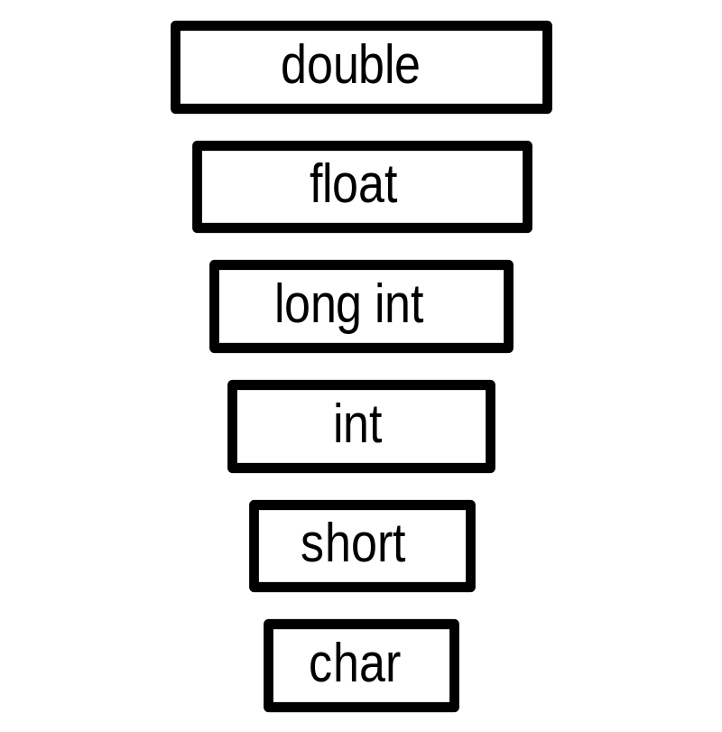
Promotion Hierarchy
Operands of the lower type can be implicitly converted to the higher type (in C)
Occurs when an operator expects the higher type (adding together two floats when one is an int)

Slide 21
Ternary Expressions
A ternary operator has three operands
Conditional Expressions
example:
average = (count == 0) ? 0 : sum / count
Evaluates as if written like
if (count == 0) average = 0
else average = sum /count

Slide 22
Example Expressions in C
// compute area:
int length = 20; // the simplest expression: a literal (here, 20)
int width = 40; // (here used to initialize a variable)
int area = length*width; // a multiplication
int average = (length+width)/2; // addition and division
The usual rules of precedence apply:
a*b+c/d means (a*b)+(c/d) and not a*(b+c)/d.
If in doubt, parenthesize. If complicated, parenthesize.
Don’t write “absurdly complicated” expressions:
a*b+c/d*(e-f/g)/h+7 // too complicated
Choose meaningful names.

Slide 23
Operands
Typical operands:
Constants: 34, 5.68, -.567
Named constants: PI, MAX, MIN, M
Variables: price, value, tax[I]
Struct members: Ann.age, Ann.name
Function Calls: sqrt(4), abs(a+b)
Parenthesized Sub Expressions: (a+b)*c, b*(c-d+e%f)

Slide 24
Operator
C language supports a rich set of built-in operators to perform different kind to operations
An operator is a symbol that tells the compiler to perform certain mathematical or logical manipulations.
Operators are used in program to manipulate data and variables.
Example :
a + b
a and b : operand
+ : operator

Slide 25
Operator & Operands
Operators only apply to certain types
  e.g., addition applies to numbers
Each operand must be of the appropriate type
Operators calculate a value
Value can then be used as operands to other operators

Slide 26


Operators in C
Arithmetic
Relational
Logical
Assignment
In / De crement
Conditional
Bitwise
Special

Slide 27

Arithmetic operators
Operator | Expression example | Meaning
+ | a + b | adds two operands
- | a – b | subtract second operands from first
* | a * b | multiply two operand
/ | a / b | divide numerator by denumerator
% | a % b | remainder of division

Slide 28
Division
If both operands of a division expression are integers, you will get an integer answer. The fractional portion is thrown away.
Examples : 17 / 5 = 3 (truncated to int)
4 / 3 = 1
35 / 9 = 3
Divide /
  Integer; integer division; 5/3 = 1

Slide 29
Division
Division where at least one operand is a floating point number will produce a floating point answer.
Examples : 17.0 / 5 = 3.4
4 / 3.2 = 1.25
35.2 / 9.1 = 3.86813
What happens? The integer operand is temporarily converted to a floating point, then the division is performed.

Slide 30
Division By Zero
Division by zero is mathematically undefined.
If you allow division by zero in a program, it will cause a fatal error. Your program will terminate execution and give an error message.
Non-fatal errors do not cause program termination, just produce incorrect results.

Slide 31
Modulus
The expression m % n yields the integer remainder after m is divided by n.
Modulus is an integer operation -- both operands MUST be integers.
Examples : 17 % 5 = 2
6 % 3 = 0
9 % 2 = 1
5 % 8 = 5

Slide 32
Uses for Modulus
Used to determine if an integer value is even or odd
5 % 2 = 1 odd 4 % 2 = 0 even
If you take the modulus by 2 of an integer, a result of 1 means the number is odd and a result of 0 means the number is even.

Slide 33


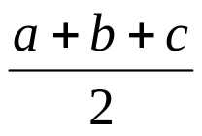
Arithmetic Expressions
Algebraic expression | C expression
axb-c | a*b-c
(m+n)(x+y) | (m+n)*(x+y)
 | a*b/c
3x²+2x+1 | 3*x*x+2*x+1
 | a/b
 | S=(a+b+c)/2
S=

Slide 34
Example program for arithmetic operators
#include <stdio.h>
int main()
{
int a=40,b=20, tambah,kurang,kali,bagi,sisaBagi;
tambah= a+b;
kurang = a-b;
kali = a*b;
bagi = a/b;
sisaBagi = a%b;
printf(“Addition of a, b is : %d\n”, tambah);
printf(“Subtraction of a, b is : %d\n”, kurang);
printf(“Multiplication of a, b is : %d\n”, kali);
printf(“Division of a, b is : %d\n”, bagi);
printf(“Modulus of a, b is : %d\n”, sisaBagi);
}
Output:
Addition of a, b is : 60
Subtraction of a, b is : 20
Multiplication of a, b is : 800
Division of a, b is : 2
Modulus of a, b is : 0

Slide 35

Relational Operators
Test the relationship between two variables, or between a variable and a constant
 | Operator | Meaning
ordering operators | < | Is less than
 | <= | Is less than or equal to
 | > | Is greater than
 | >= | Is greater than or equal to
equality operators | == | Equal to
 | != | Not equal to

Slide 36
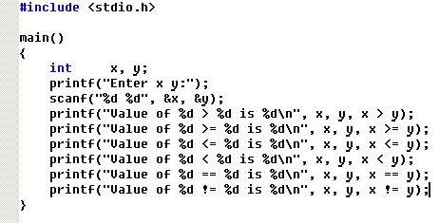
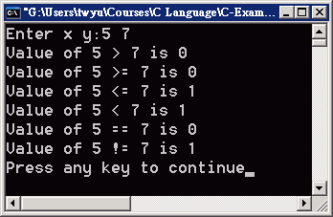
Example: Relation Operator

Slide 37

Logical Operators
Logical expressions have the one of two values - true or false
C has no Boolean type: it uses int type with 0 for false and nonzero for true ( false = 0 and true = all nonzero)
Logical operators are symbols that are used to combine or negate expressions containing relational operators Example: if (a>10) && (a<20)

Slide 38
Logical Operators
Operator | Meaning
&& | Logical AND
|| | Logical OR
! | Logical NOT
Truth Table
Operand 1 | Operand 2 | op1 || op2 | op1 && op2 | ! op1
0 | 0 | 0 | 0 | 1
0 | non-zero | 1 | 0 | 1
non-zero | 0 | 1 | 0 | 0
non-zero | non-zero | 1 | 1 | 0

Slide 39
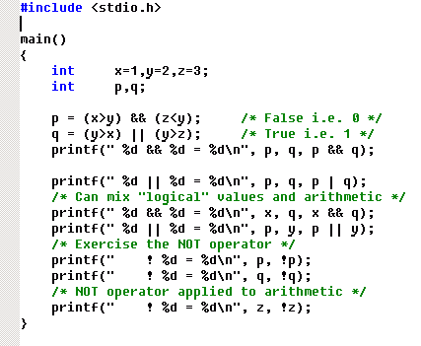
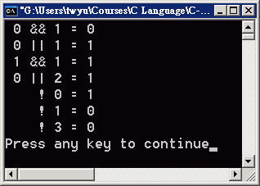
Example: Logical Operator

Slide 40
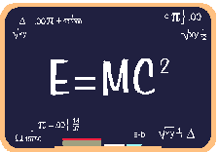
Assignment operators
Assignment operators are used to combine the '=' operator with one of the binary arithmetic operators
Syntax:
v op = exp;
Where v = variable,
op = shorthand assignment operator
exp = expression
Example :
x = x+3
x + = 3

Slide 41

Shorthand Assignment operators
Simple assignment operator | Shorthand operator
a = a +1 | a + = 1
a = a - 1 | a - = 1
a = a * (m+n) | a * = m + n
a = a / (m+n) | a / = m + n
a = a % b | a % = b

Slide 42
Example Assignment Operators
In the following slide, All operations starting from c = 9
Operator | Example | Equivalent Statement | Results
+= | c += 7 | c = c + 7 | c = 16
-= | c -= 8 | c = c – 8 | c = 1
*= | c *= 10 | c = c * 10 | c = 90
/= | c /= 5 | c = c / 5 | c = 1
%= | c %= 5 | c = c % 5 | c = 4

Slide 43
Practice with Assignment Operators
int i = 1, j = 2, k = 3, m = 4 ;
Expression Value
i += j + k
j *= m + 5
k -= m /= j * 2

Slide 44
Increment and Decrement Operators
Prefix: value changed before being used
Postfix: value used before being changed
++ (Increment Operator)
The ++ operator adds a value 1 to the operand
  Prefix: ++n
  Postfix: n++
-- (Decrement Operator)
The ––operator subtracts 1 from the operand
  Prefix: --n
  Postfix: n--

Slide 45

Rules for ++ & -- operators
These require variables as their operands
When prefix either ++ or –– is used with the variable in a given expression, it is incremented or decremented by one first and then the expression is evaluated with the new value
When postfix either ++ or –– is used with the variable in a given expression, the expression is evaluated first and then it is incremented or decremented by one

Slide 46
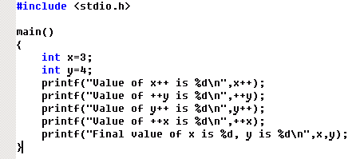
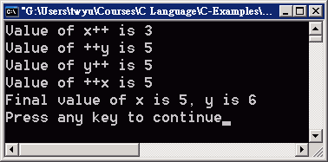
Example: Increment and Decrement Operators

Slide 47
Increment and Decrement Operators
  count ++; count = count +1;
  sum = ++count; count = count +1;
  sum = count;
  sum = count++; sum = count;
  count = count +1;
  - count ++; - (count ++);

Slide 48
Examples for ++ & -- operators
The position of the ++ determines when the value is incremented. If the ++ is after the variable, then the incrementing is done last (a post increment).
int amount, count ;
count = 3 ;
amount = 2 * count++ ;
amount gets the value of 2 * 3, which is 6, and then 1 gets added to count.
So, after executing the last line, amount is 6 and count is 4.

Slide 49
Examples for ++ & -- operators
If the ++ is before the variable, then the incrementing is done first (a preincrement).
int amount, count ;
count = 3 ;
amount = 2 * ++count ;
1 gets added to count first, then amount gets the value of 2 * 4, which is 8.
So, after executing the last line, amount is 8 and count is 4.

Slide 50
Examples for ++ & -- operators
The position of the -- determines when the value is decremented. If the -- is after the variable, then the decrementing is done last (a post decrement).
int amount, count ;
count = 3 ;
amount = 2 * count-- ;
amount gets the value of 2 * 3, which is 6, and then 1 gets subtracted from count.
So, after executing the last line, amount is 6 and count is 2.

Slide 51
Examples for ++ & -- operators
If the -- is before the variable, then the decrementing is done first (a predecrement).
int amount, count ;
count = 3 ;
amount = 2 * --count ;
1 gets subtracted from count first, then amount gets the value of 2 * 2, which is 4.
So, after executing the last line, amount is 4 and count is 2.

Slide 52
The following table illustrates the difference between the prefix and postfix modes of the increment and decrement operator.
Examples for ++ & -- operators
int R = 10, count=10;
++ Or -- Statement | Equivalent Statements | R value | Count value
R = count++; | R = count; count = count + 1 | 10 | 11
R = ++count; | count = count + 1; R = count; | 11 | 11
R = count --; | R = count; count = count – 1; | 10 | 9
R = --count; | Count = count – 1; R = count; | 9 | 9

Slide 53
Practice
Given
int a = 1, b = 2, c = 3 ;
What is the value of this expression?
++a * b - c--
What are the new values of a, b, and c?

Slide 54
More Practice
Given
int a = 1, b = 2, c = 3, d = 4 ;
What is the value of this expression?
++b / c + a * d++
What are the new values of a, b, c, and d?

Slide 55

Conditional operators
Syntax:
Expression_1 ? Expression_2 : Expression_3
Working of the ? Operator:
Expression_1 is evaluated first, if it is nonzero(1/true) then the expression_2 is evaluated and this becomes the value of the expression,
If expression_1 is false(0/zero) expression_3 is evaluated and its value becomes the value of the expression

Slide 56
Conditional Operator
Example :
1) x = (a < b) ? a : b; “ if (a < b)
x = a;
else
x = b; ”
(a < b) ? a : b = x; “ if (a < b)
a = x;
else
b = x; ”
2)Average = (count == 0)? 0: sum/count;
If (count ==0) average =0;
else average = sum/count;

Slide 57
Program to show the use of conditional operator
#include<stdio.h>
#include<conio.h>
void main()
{
clrscr();
printf(“Enter value for a & b: “);
scanf(“%d%d”,&a,&b);
(a>b)?printf(“a is greater”):printf(“b is greater”);
getch();
}
Output:
Enter value for a & b: 5
7
b is greater

Slide 58

Bitwise operators
These operators allow manipulation of data at the bit level
Operator | Meaning
& | Bitwise AND
| | Bitwise OR
^ | Bitwise exclusive OR
<< | Shift left
>> | Shift right

Slide 59
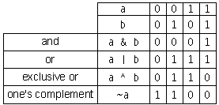
Bitwise Operators
Bitwise "and" operator &
Bitwise "or" operator |
Bitwise "exclusive or" operator ^
Bitwise "ones complement" operator ~
Shift left <<
Shift right >>

Slide 60
Bitwise AND
#include <stdio.h>
main()
{
unsigned char a,b;
a=17;
b=22;
a=a & b;
printf("%d\n",a);
}

Slide 61
Program to use bitwise AND operator between the two integers
#include<stdio.h>
#include<conio.h>
void main()
{
int a,b,c;
clrscr();
printf(“Read the integers from keyboard: “);
scanf(“%d %d”,&a,&b);
c=a&b;
printf(“The Answer after ANDing is: %d “,c);
getch();
}
Output:
Read the integers from keyboard: 8 4
The Answer after ANDing is: 0

Slide 62
Bitwise NOT
#include <stdio.h>
main()
{
unsigned char a;
a=17;
a=~a;
printf("%d\n",a);
}

Slide 63
Bitwise Operators
Operation | Operator | Comment | Value of Sum before | Value of sum after
AND | & | sum = sum & 2; | 4 | 0
OR | | | sum = sum | 2; | 4 | 6
Exclusive OR | ^ | sum = sum ^ 2; | 4 | 6
1's Complement | ~ | sum = ~sum; | 4 | -5
Left Shift | << | sum = sum << 2; | 4 | 16
Right Shift | >> | sum = sum >> 2; | 4 | 1
1=00000000 00000000 00000000 00000001
2=00000000 00000000 00000000 00000010
4=00000000 00000000 00000000 00000100
8=00000000 00000000 00000000 00001000
16=00000000 00000000 00000000 00010000
5=00000000 00000000 00000000 00000101
11111111 11111111 11111111 11111010
-5=11111111 11111111 11111111 11111011

Slide 64
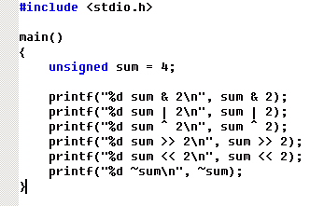
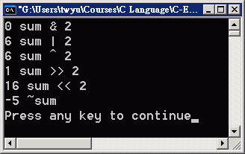
Example: Bitwise Operators
1=00000000 00000000 00000000 00000001
2=00000000 00000000 00000000 00000010
4=00000000 00000000 00000000 00000100
8=00000000 00000000 00000000 00001000
16=00000000 00000000 00000000 00010000
5=00000000 00000000 00000000 00000101
11111111 11111111 11111111 11111010
-5=11111111 11111111 11111111 11111011

Slide 65
Operating on Bits
C allows you to operate on the bit representations of integer variables.
  Generally called bit-wise operators.
All integers can be thought of in binary form.
  For example, suppose ints have 16-bits
    65520₁₀ = 1111 1111 1111 0000₂ = FFF0₁₆ = 177760₈
In C, hexadecimal literals begin with 0x, and octal literals begin with 0.
    x=65520; base 10
    x=0xfff0; base 16 (hex)
    x=0177760; base 8 (octal)

Slide 66
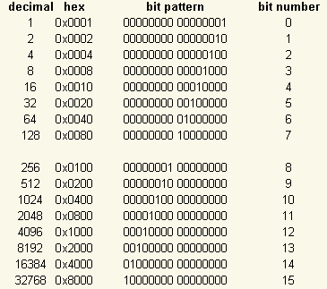
Base 2

Slide 67
operators &, |, ^,~
The value of each bit is determined only by the
bit(s) in its position
Examples: int a = 33333, b = -77777;
Expression | Representation | Value
a | 00000000 00000000 10000010 00110101 | 33333
b | 11111111 11111110 11010000 00101111 | -77777
a & b | 00000000 00000000 10000000 00100101 | 32805
a ^ b | 11111111 11111110 01010010 00011010 | -110054
a | b | 11111111 11111110 11010010 00111111 | -77249
~ ( a | b ) | 00000000 00000001 00101101 11000000 | 77248
~ a & ~ b | 00000000 00000001 00101101 11000000 | 77248

Slide 68
Operating on Bits
Bitwise operators
The shift operator:
  x << n
    Shifts the bits in x n positions to the left, shifting in zeros on the right.
    If x = 1111 1111 1111 0000₂
      x << 1 equals 1111 1111 1110 0000₂
  x >> n
    Shifts the bits in x n positions right.
      shifts in the sign if it is a signed integer (arithmetic shift)
      shifts in 0 if it is an unsigned integer
    x >> 1 is 0111 1111 1111 1000₂ (unsigned)
    x >> 1 is 1111 1111 1111 1000₂ (signed)

Slide 69
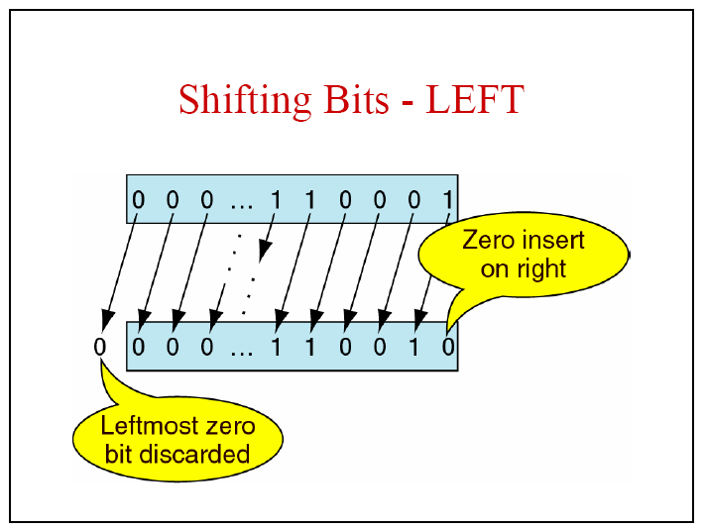

Slide 70
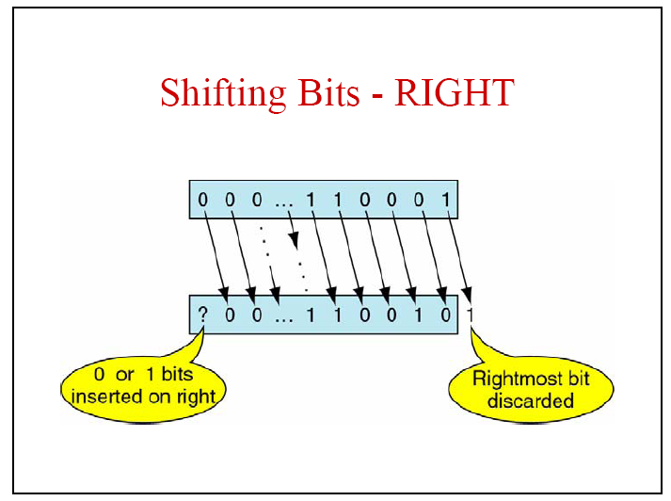

Slide 71
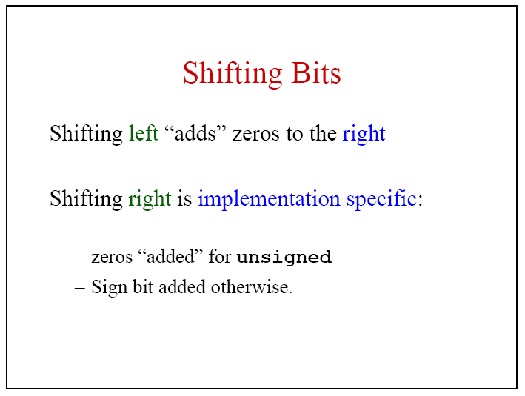


Slide 72
Left/Right shift
#include <stdio.h>
main()
{
unsigned char a,b;
a=17;
a=a << 2;
b=64;
b=b >> 3;
printf("%d %d\n",a,b);
}

Slide 73
#include <stdio.h>
main()
{
char a,b;
a=17;
a=a >> 2;
b=-65;
b=b >> 2;
printf("%d %d\n",a,b);
}

Slide 74
Bitwise right-shift (negative)
#include <stdio.h>
main()
{
char a,b;
a=17;
a=a >> 2;
b=-65;
b=b >> 2;
printf("%d %d\n",a,b);
}

Slide 75
Implementation Note
0x0001
0x0002
0x0004
0x0008
0x0010
0x0020
0x0040
0000000000000001
x<<n is equivalent
to multiplication by 2^{n}.
x>>n is equal to x/2^{n}
Shifting is much faster
than actual multiplication (*) or division (/)
==> Multiplications / divisions by powers of 2 should be implemented using shifts.
0000000000000010
0000000000000100
0000000000001000
0000000000010000
0000000000100000
0000000001000000

Slide 76
Shift, Multiplication and Division
Multiplication and division is often slower than shift.
Multiplying 2 can be replaced by shifting 1 bit to the left.
    n = 10
    printf(“%d = %d” , n*2, n<<1);
    printf(“%d = %d”, n*4, n<<2);
    ……
Division by 2 can be replace by shifting 1 bit to the right.
    n = 10
    printf(“%d = %d” , n/2, n>>1);
    printf(“%d = %d”, n/4, n>>2);

Slide 77
Program to shift inputed data by three bits to the left.
#include<stdio.h>
#include<conio.h>
void main()
{
int x,y;
clrscr();
printf(“Read the integer from keyboard “);
scanf(“%d”,&x);
x<<=3;
y=x;
printf(“The left shifted data is = %d”,y);
getch();
}
Output:
Read the integer from keyboard 2
The left shifted data is = 16

Slide 78
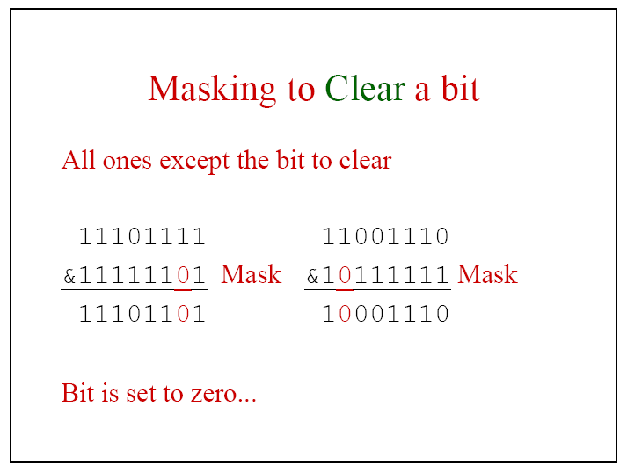

Slide 79
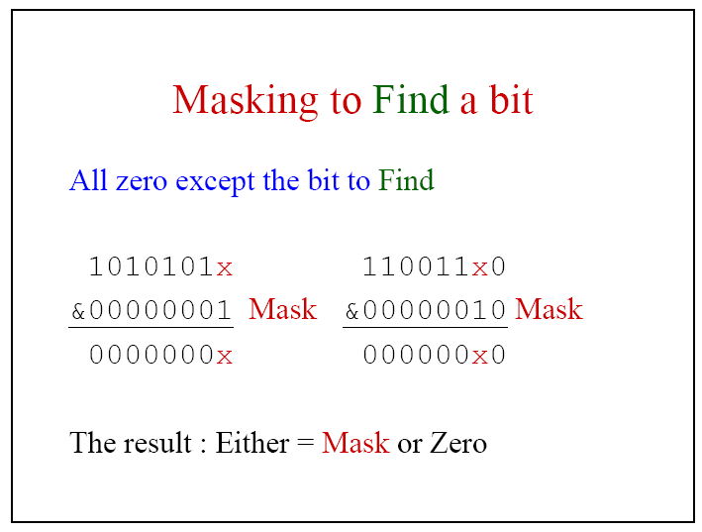

Slide 80
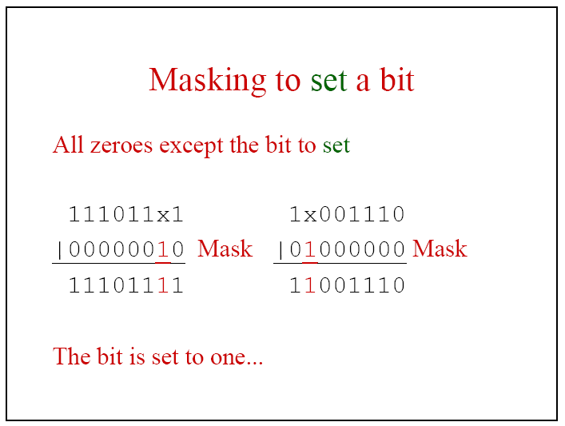

Slide 81
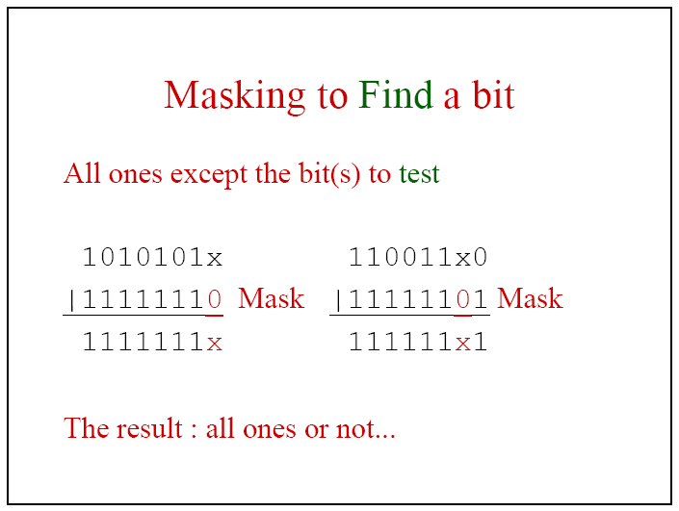

Slide 82
Bitmasks
/* This program demonstrates setting a bit, clearing a bit, and reading a bit.*/
#include <stdio.h>
main()
{
char a;
int i;
a=17;
a=a | (1 << 3); /* set 3rd bit */
printf("%d\n",a);
a=a & (~(1<<4)); /* clear 4th bit */
printf("%d\n",a);
for (i=7; i>=0; i--)
printf("%d ",(a&(1<<i)) >> i); /* read i'th bit */
printf("\n");
}

Slide 83

Special operators
Comma operator ( ,)
sizeof operator – sizeof( )
Pointer operators – ( & and *)
Member selection operators – ( . and ->)

Slide 84
Comma Operator
An expression can be composed of multiple subexpressions separated by commas.
  Subexpressions are evaluated left to right.
  The entire expression evaluates to the value of the rightmost subexpression.
Example:
  x = (a++, b++);
    a is incremented
    b is assigned to x
    b is incremented
  Parenthesis are required because the comma operator has a lower precedence than the assignment operator!
The comma operator is often used in for loops.

Slide 85
Comma Operator and For Loop
Example:
int i, sum;
for (i=0,sum=0;i<100;i++){
sum += i;
}
printf(“1+...+100 = %d”, sum);

Slide 86
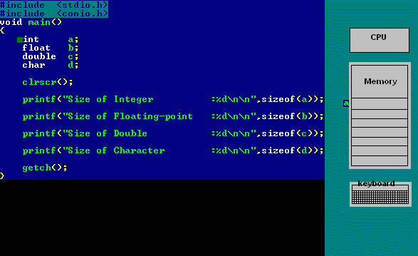
sizeof operator
Size of Integer :2
Size of Floating-point :4
Size of Double :8
Size of Character :1

Slide 87
Complex Expressions
Expressions can be composed to produce more complex expressions
  operand of expression can be an expression:
  total = totalSale + taxRate * totalSale
  three operators, =, +, *, how is this expression resolved??
  In C, taxRate * totalSale is calculated, then totalSale is added to this value, then this value is stored in total
  But why??

Slide 88
Expressions: Design Issues
Design issues for complex expressions
operator precedence rules
operator associativity rules
order of operand evaluation
operand evaluation side effects
mode mixing expressions

Slide 89
Precedence of operators
Precedence deal with the evaluation order within expressions
Precedence rules specify the order in which operators of different precedence level are evaluated
Operators with higher precedence are evaluated first.
BODMAS RULE-Brackets of Division Multiplication Addition Subtraction
Brackets will have the highest precedence and have to be evaluated first, then comes of , then comes division, multiplication, addition and finally subtraction.
C language uses some rules in evaluating the expressions and they called as precedence rules or sometimes also referred to as hierarchy of operations, with some operators with highest precedence and some with least.

Slide 90
C Operator Precedence
Category | Operator
Postfix | () [] -> . ++ - -
Unary | + - ! ~ ++ - - (type) * & sizeof
Multiplicative | * / %
Additive | + -
Shift | << >>
Relational | < < = > >=
Equality | == !=
Bitwise AND | &
Bitwise XOR | ^
Bitwise OR | |
Logical NOT | !
Logical AND | &&
Logical OR | ||
Conditional | ?:
Assignment | = += -= *= /= %= >>= <<= &= ^= |=
Comma | ,

Slide 91
Associativity
Associativity deal with the evaluation order within expressions
Associativity rules specify the order in which operators of the same precedence level are evaluated
  left to right (left associativity)
    A + B + C means (A + B) + C
  right to left (right associativity)
    A + B + C means A + (B + C)
Most C arithmetic operators are “left associative”, within the same precedence level
  a / b * c equals (a / b) * c
  a + b - c + d equals ( ( a + b ) - c ) + d
C also has a few operators that are right associative

Slide 92
Associativity
Rules determining how to evaluate expressions containing more than one operator with the same precedence
example: 5 - 4 - 3
is ((5 - 4) - 3) or (5 - (4 - 3)) ?
  its important because the values may differ
  (e.g., -2 or 4 for the above possibilities)
Left associativity: operators are evaluated left to right
Right associativity: evaluated right to left

Slide 93
Operators | Associativity
() [] . -> ++(postfix) --(postfix) | left to right
+(unary) -(unary) ++(prefix) --(prefix) ! sizeof(type) &(address) *(dereference) ~ | right to left
* / % | left to right
+ - | left to right
<< >> | left to right
< <= > >= | left to right
== != | left to right
& | left to right
^ | left to right
| | left to right
&& | left to right
|| | left to right
?: | right to left
= += -= *= /= &= >>= etc | right to left
,(comma operator) | left to right
C Operator Associativity

Slide 94
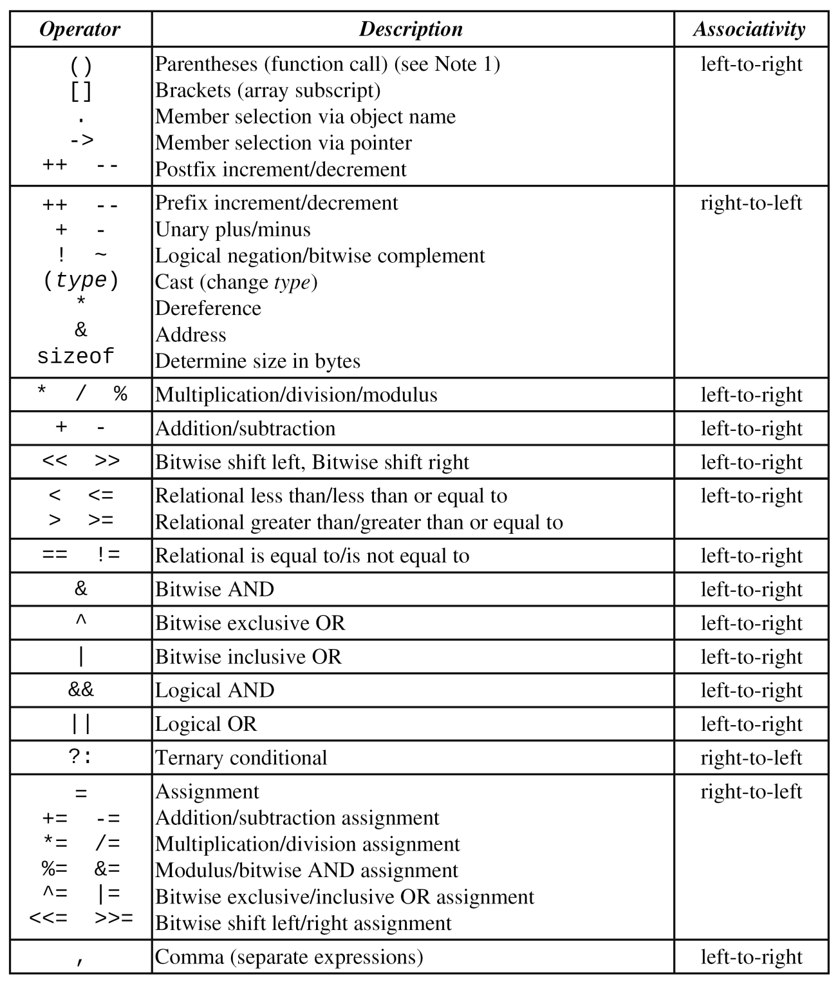
C Operator Precedence and Associativity

Slide 95
Rules for evaluation of expression
First parenthesized sub expression from left to right are evaluated (Precedence and associativity rules can be overriden with parentheses)
If parentheses are nested, the evaluation begins with the innermost sub expression
The precedence rule is applied in determining the order of application of operators in evaluating sub expressions
    Define the order in which the operators of different precedence levels are evaluated (e.g., + vs * )
The associatively rule is applied when 2 or more operators of the same precedence level appear in a sub expression.
Arithmetic expressions are evaluated from left to right using the rules of precedence
When parentheses are used, the expressions within parentheses assume highest priority

Slide 96
Example
Evaluate the expression when a=4
b = a- ++a
= a – 5
= 5 - 5
= 0

Slide 97
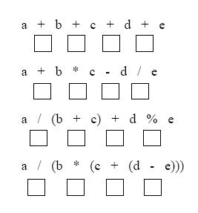
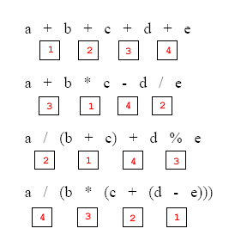
Label the execution order for the following expressions

Slide 98
Precedence and Associativity: Example
Mathematical formula:
________
- b + √ b² - 4 a c
----------------------
2 a
C formula:
(- b + sqrt ( b * b - 4.0 * a * c) ) / ( 2.0 * a )
Notes:
Maybe a better example here?

Slide 99
Precedence for Logical Operators
Consider the following expression
False OR True AND NOT False AND True
This condition gets evaluated as shown below:
False OR True AND [NOT False] AND True
NOT has the highest precedence.
False OR True AND [True AND True]
AND is the operator of the highest precedence and operators of the same precedence are evaluated from right to left
False OR [True AND True]
[False OR True]
True

Slide 100
Precedence among Operators
Consider the following example:
2*3+4/2 > 3 AND 3<5 OR 10<9
[2*3+4/2] > 3 AND 3<5 OR 10<9
[[2*3]+[4/2]] > 3 AND 3<5 OR 10<9
[6+2] >3 AND 3<5 OR 10<9
[8 >3] AND [3<5] OR [10<9]
True AND True OR False
[True AND True] OR False
True OR False
True

Slide 101
Changing Precedence
Parenthesis ( ) has the highest level of precedence
The precedence of operators can be modified using parenthesis ( )
Operator of lower precedence with parenthesis assume highest precedence and gets executed first
In case of nested Parenthesis ( ( ( ) ) ) the inner most parenthesis gets evaluated first
An expression consisting of many set of parenthesis gets processed from left to right

Slide 102
Changing Precedence
Consider the following example:
5+9*3^2-4 > 10 AND (2+2^4-8/4 > 6 OR (2<6 AND 10>11))
5+9*3^2-4 > 10 AND (2+2^4-8/4 > 6 OR (True AND False))
5+9*3^2-4 > 10 AND (2+2^4-8/4 > 6 OR False)
5+9*3^2-4 >10 AND (2+16-8/4 > 6 OR False)
5+9*3^2-4 > 10 AND (2+16-2 > 6 OR False)
5+9*3^2-4 > 10 AND (18-2 > 6 OR False)
5+9*3^2-4 > 10 AND (16 > 6 OR False)
5+9*3^2-4 > 10 AND (True OR False)
5+9*3^2-4 > 10 AND True

Slide 103
Changing Precedence
5+9*9-4>10 AND True
5+81-4>10 AND True
86-4>10 AND True
82>10 AND True
True AND True
True

Slide 104
Operand Evaluation Order
When do we evaluate operand?
  Variables are evaluated by fetching their values from memory
  Constants
    Sometimes, constants are evaluated by fetching its value from memory;
    At other times, it is part of the machine language instruction
  Parenthesized expressions
    If operand is a parenthesized expression, all operators it contains must be evaluated before its value can be used as an operand
  Function calls
    Must be evaluated before its value can be used as an operand

Slide 105
Composing Assignments
A = B = EXPR
This statement in C is not a Composing / Multiple assignment expression
Here, B = EXPR has a value (equal to the value of EXPR). This value is next assigned to A: the assignment operator in C associates right-to-left.

Slide 106
Composing Assignments
Example:
  x = y = 3 (x = (y = 3)) with Right associativity
  Ok to do, but better to avoid
Example:
  x is 4, what is the result of x = y = x + 3 ?
  x + 3 evaluated (producing 7), this value stored to y, then the result stored back to x

Slide 107
Multiple Assignments
In ANSI C, changing a variable multiple times in the same expression produces an undefined result
  example: (b-- + b--)
  is undefined, C may execute both b-- operators together, the left b-- first, or the right b-- first
  solution: better not to do it

Slide 108
Side Effects
A side effect is when a function or operator does more than just return a value
  change a parameter or global variable
  usually considered a bad programming practice
If side effects are possible, then the order in which an operator’s operands are evaluated can have an impact on the result
  in C
    x = 3; z = x * ++x; /* 12 or 16?*/
    x = 3; a[x] = x++; /* assign 3 to a[3] or a[4]? */

Slide 109
Side Effects
Certain operations not only produce values, but also perform other actions
  assignment statements - change the value of variable on left-hand side of operator
  scanf operator - returns a value (number of arguments read), but also changes variables in scanf expression
    example: scanf(“%d”,&total) changes total

Slide 110
Side Effects and Evaluation Order
One solution: write the language definition to disallow functional side effects
Another solution: write the language definition to demand that operand evaluation order be fixed

Slide 111
Short Circuit Evaluation
Evaluating an expression without evaluating all the operands.
An expression in which the result is determined without evaluating all of the operands and/or operators
Example: (a > b && c > 5)
If we know that a > b is false, then there is no need to determine whether (c > 5) is true
(13*a) * (b/13–1)
If a is zero, there is no need to evaluate (b/13-1)
(a > 3 && b < 5 * d)
If a <= 3, there is no need to evaluate b < 5 * d

Slide 112
Short Circuit Evaluation
C evaluates the && and || operators using a strategy called short-circuit mode in which it evaluates the right operand only if it needs to do so.
For example
(n != 0 && x % n == 0)
If n is 0, the right hand operand of && in is not evaluated at all because n != 0 is false.
Because the expression false && anything is always false, the rest of the expression no longer matters.
One of the advantages of short-circuit evaluation is that you can use && and || to prevent execution errors. If n were 0 in the earlier example, evaluating x % n would cause a “division by zero” error.
.

Slide 113
Mixed-Type Assignment Expressions
Mixed-type expression : an expression with operands of different types
The data type of such a mixed-type expression will be double
When an assignment expression is executed, the expression is first evaluated; then the result is assigned to the variable listed to the left of the assignment operator (=).
Mixed-type assignment
  the expression being evaluated and the variable to which it is assigned have different data types
.

Slide 114
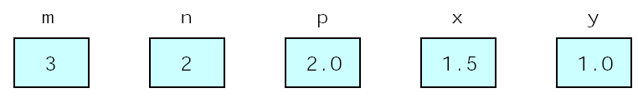
Mixed-Type Assignment Expression
The expression is evaluated before the assignment is made, and the type of the variable being assigned has no effect whatsoever on the expression value.
E.g.
  int m, n;
  double x,y;
  m = 3;
  n = 2;
  p = 2.0;
  x = m / p;
  y = m / n;

Slide 115
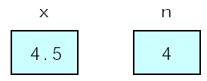
Mixed-Type Assignment Expression
Assignment of a type double expression to a type int variable causes the fractional part of the expression to be lost since it cannot be represented in a type int variable.
E.g.
  double x;
  int n;
  x = 9 * 0.5;
  n = 9 * 0.5;

Slide 116
Type Conversions
Often want to write expressions that are mixed mode (contain operands of more than one type) example : real + integer
This implies a need to convert one type to another so the expression can be evaluated
  coercion is implicit conversion, done automatically by the compiler
    implies semantics that define rules for determining type to convert to from operands
    problem is loss of error detection
  casts are explicit conversions specified by the programmer
    can lead to very clumsy expressions if doing a lot of mixed mode expressions
    example : (int) speed;

Slide 117
Type Conversions (continued)
Whether implicit or explicit, conversions can be
  widening
    convert to a type with a greater representation range
      although perhaps with a loss of precision
    integer to float
  narrowing
    convert to a type with a more restricted range
    float to integer

Slide 118
Type Conversions
Implicit casting
double d = 3; (type widening)
Explicit casting
int i = (int)3.0; (type narrowing)
What is wrong? int x = 5/2.0;

Slide 119
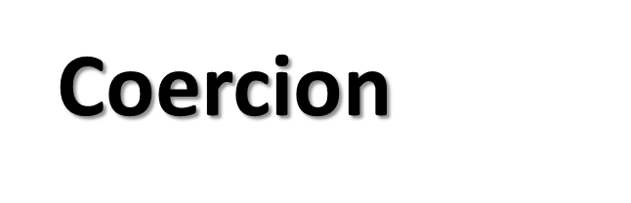
  char and short operands are converted to int
  Lower data types are converted to the higher data types and result is of higher type.
  The conversions between unsigned and signed types may not yield intuitive results.
  Example
  float f; double d; long l;
  int i; short s;
  d + f f will be converted to double
  i / s s will be converted to int
  l / i i is converted to long; long result
The Hierarchy
Double
float
long
Int
Short and char

Slide 120
Coercion
  (A < B < C) is a legal expression
    A < B yields a Boolean value, which is a single bit 0 or 1
    convert bit string to integer to compare to C
    bit <= C is true for any positive values of C
    There is never comparison between B and C
    Consider: 8 < 7 < 1

Slide 121

  The general form of a type casting operator is
  (type-name) expression
  It is generally a good practice to use explicit casts than to rely on automatic type conversions.
  Example
  C = (float)9 / 5 * ( f – 32 )
  float to int conversion causes truncation of fractional part
  double to float conversion causes rounding of digits
  long int to int causes dropping of the higher order bits.

Slide 122
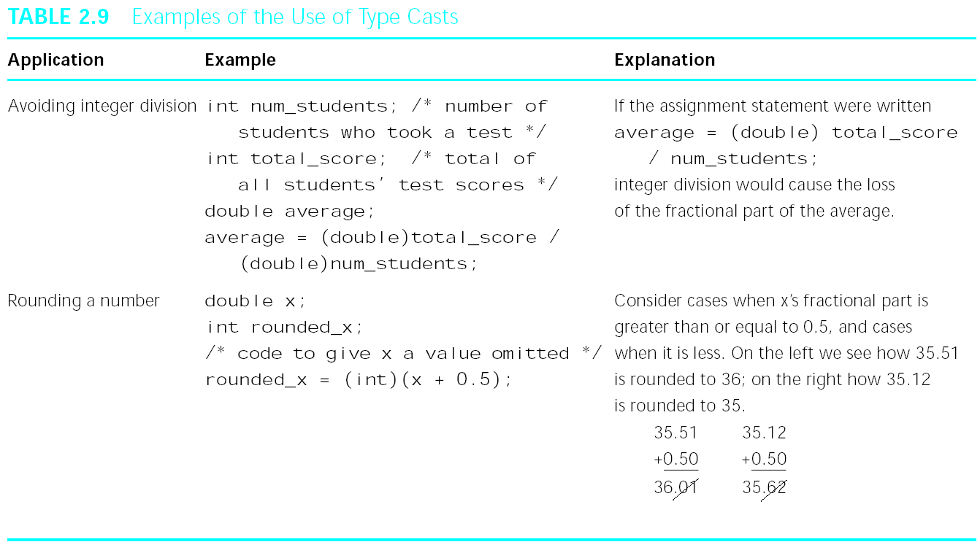
Casts

Slide 123


Questions?

